Slide 1
CareerCrafter – Job Portal
Trainer: JAVEED MOHAMMED HUSNUDDIN Presented By: P. Sutej Reddy

Slide 2
Technologies, Tools Used:
Backend Technologies:
Java with Spring Boot framework for building RESTful APIs.
Spring Security with JWT for authentication and authorization.
Spring Data JPA with Hibernate for database interaction.
MySQL as the relational database for storing jobs, users, and applications.
Log4J for logging application events.
Frontend Technologies:
React with modern functional components and hooks.
Bootstrap for responsive UI design.
React Router DOM for client-side routing.
React Hook Form with validation.
Axios for HTTP API calls.

Slide 3
Introduction:
CareerCrafter is a modern online job portal system that streamlines the recruitment process by connecting job seekers with potential employers. It provides a secure, user-friendly platform where employers can post jobs, manage jobs review applications and manage applications, while job seekers can create and manage their profiles, upload resumes, search for jobs, and apply easily and view their application status. This system aims to replace traditional, manual job search and hiring methods with a scalable, automated digital solution.

Slide 4
Project Description:
The project focuses on building a full-stack web application consisting of a Spring Boot backend and React frontend. The backend exposes RESTful APIs along with authentication and role-based access controls implemented using JWT for security.
The React frontend delivers a seemless experience, enabling job seekers and employers to interact easily. Job seekers can search job listings, maintain resumes, and track application statuses. Employers can post jobs, view applicant profiles, update application statuses.
Key features include job recommendations based on user profiles and efficient application tracking system. The project aims to deliver a streamlined hiring experience with enhanced transparency and efficiency.

Slide 5
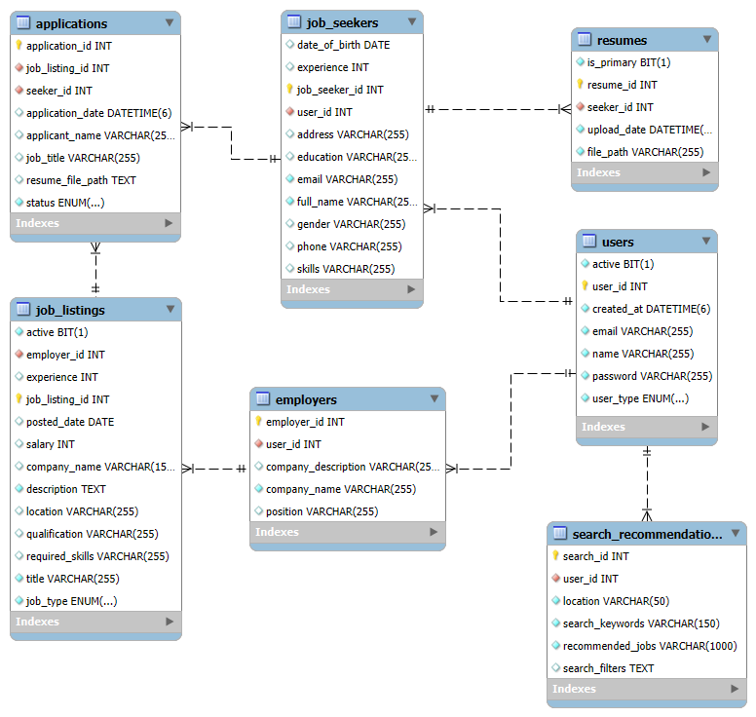
ER Diagram:

Slide 6
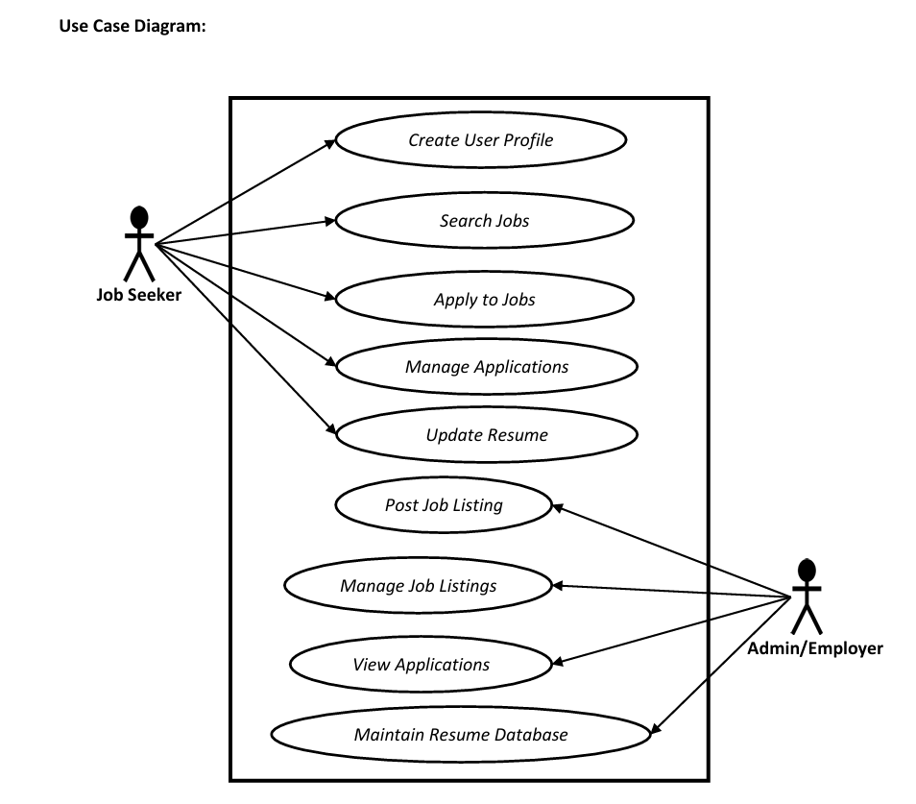
Use Case Diagram:

Slide 7
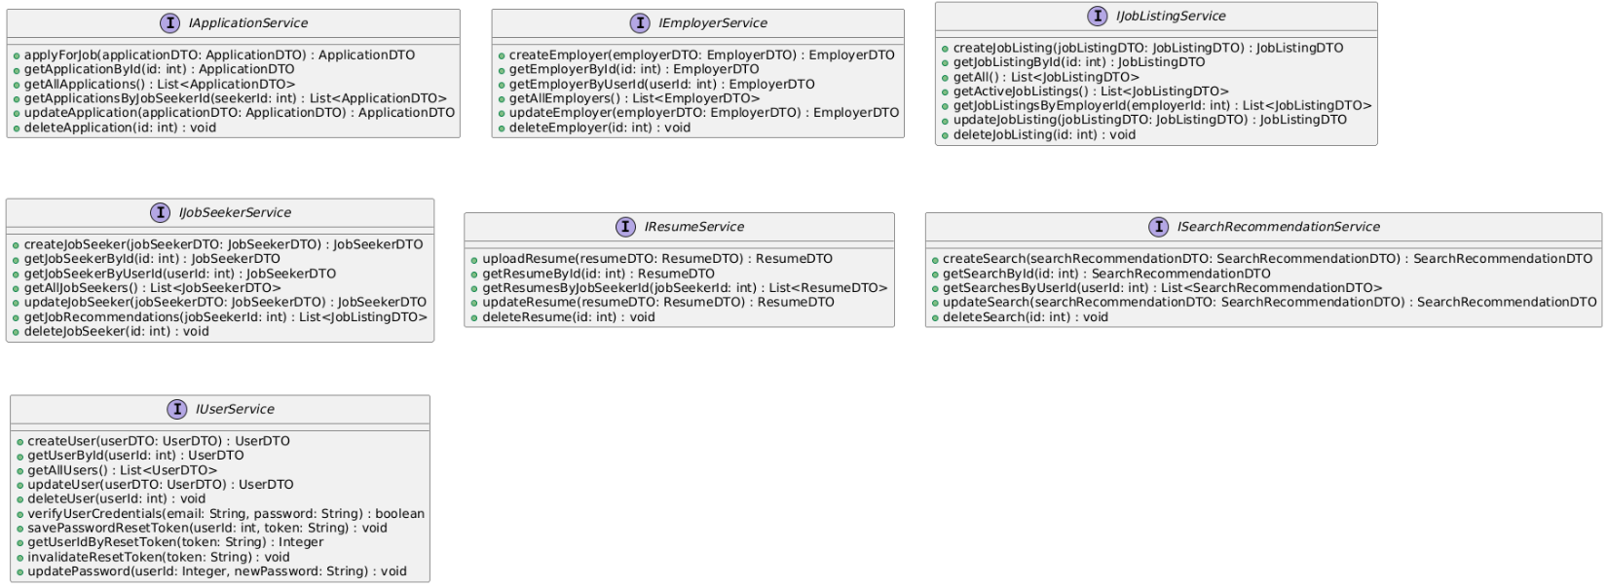
Class Diagram:

Slide 8
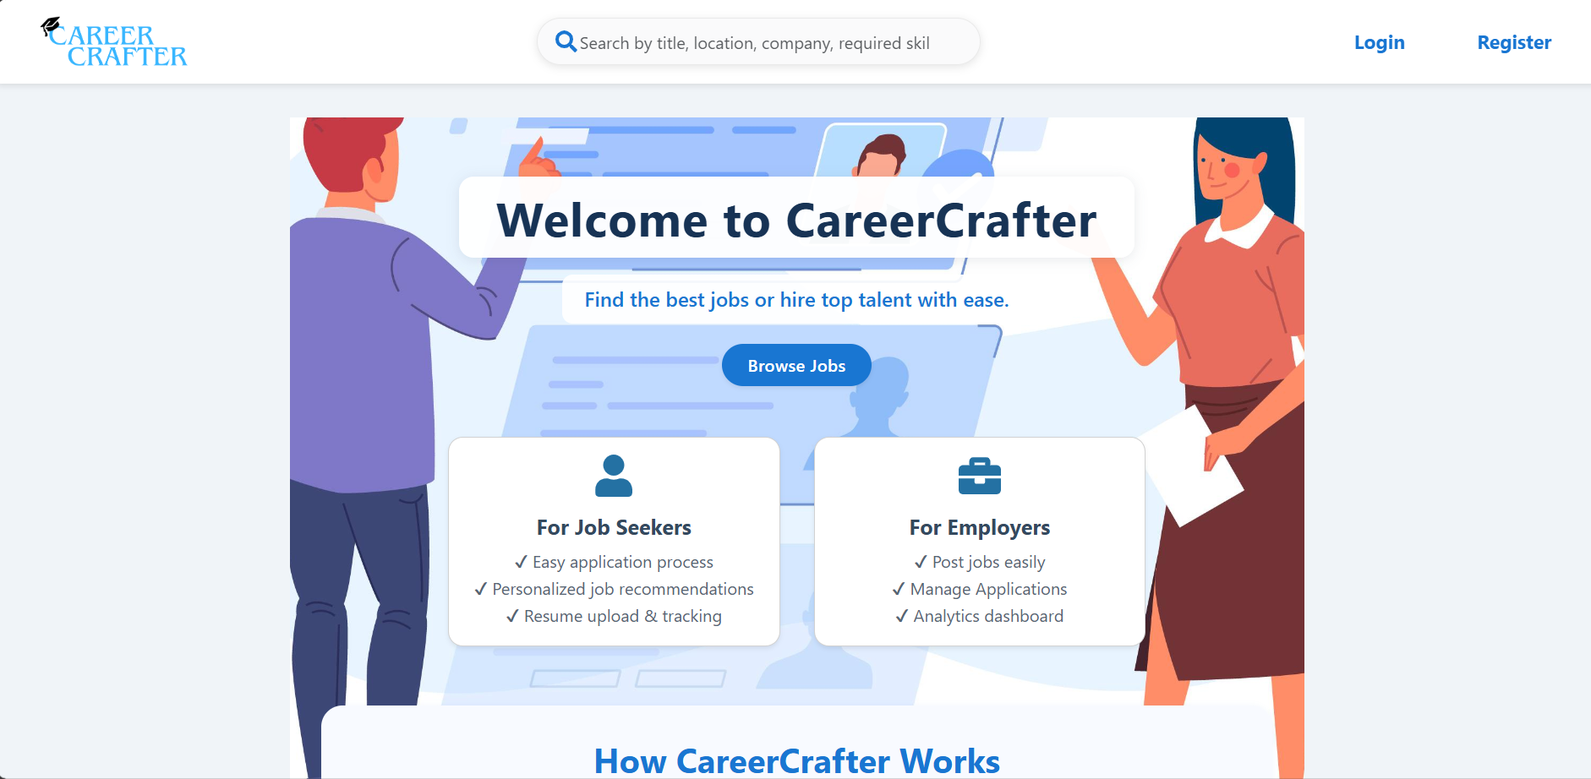
Home Page:

Slide 9
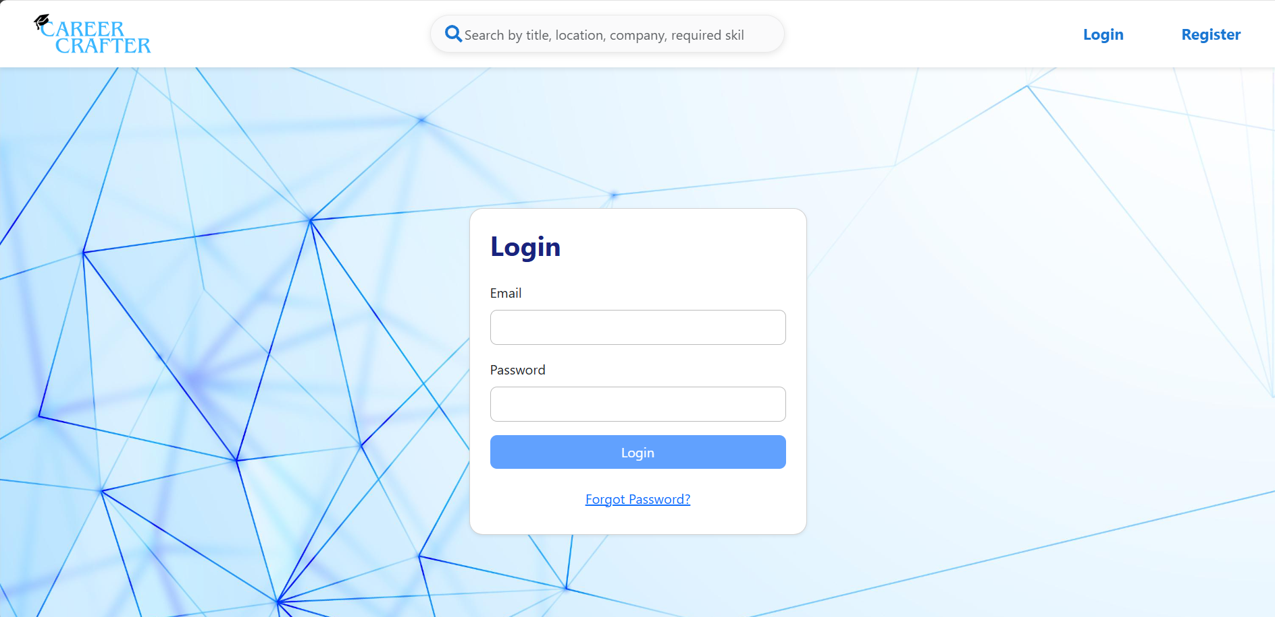
Login Page:

Slide 10
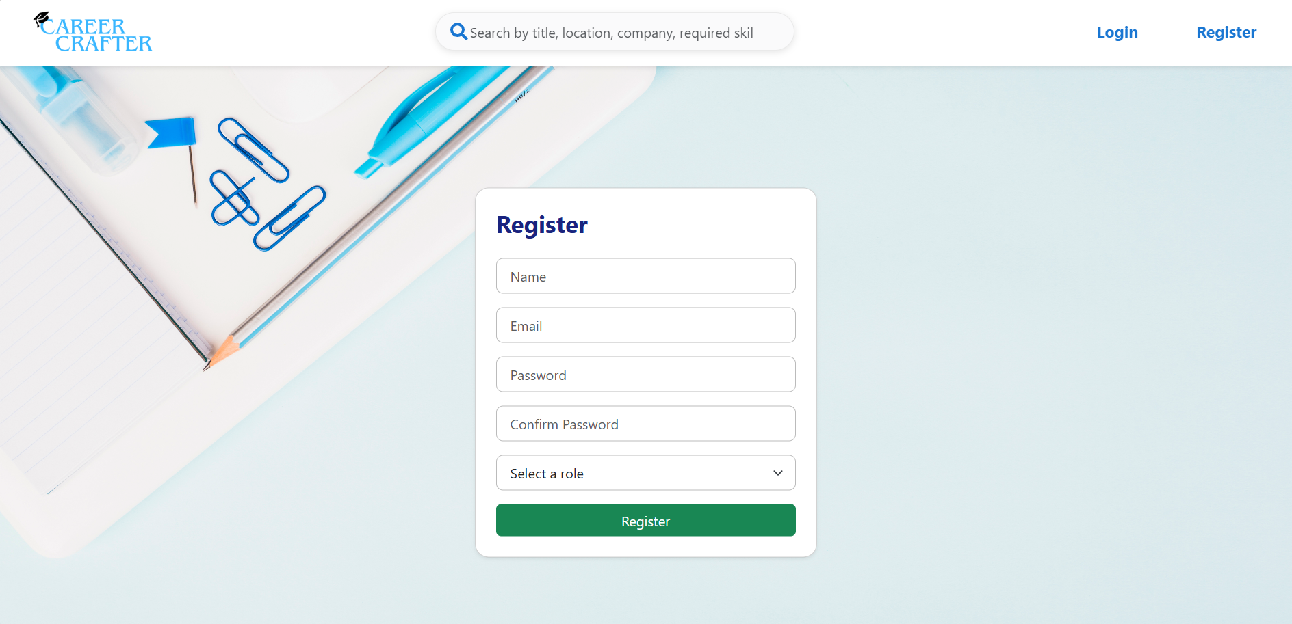
Register Page:

Slide 11
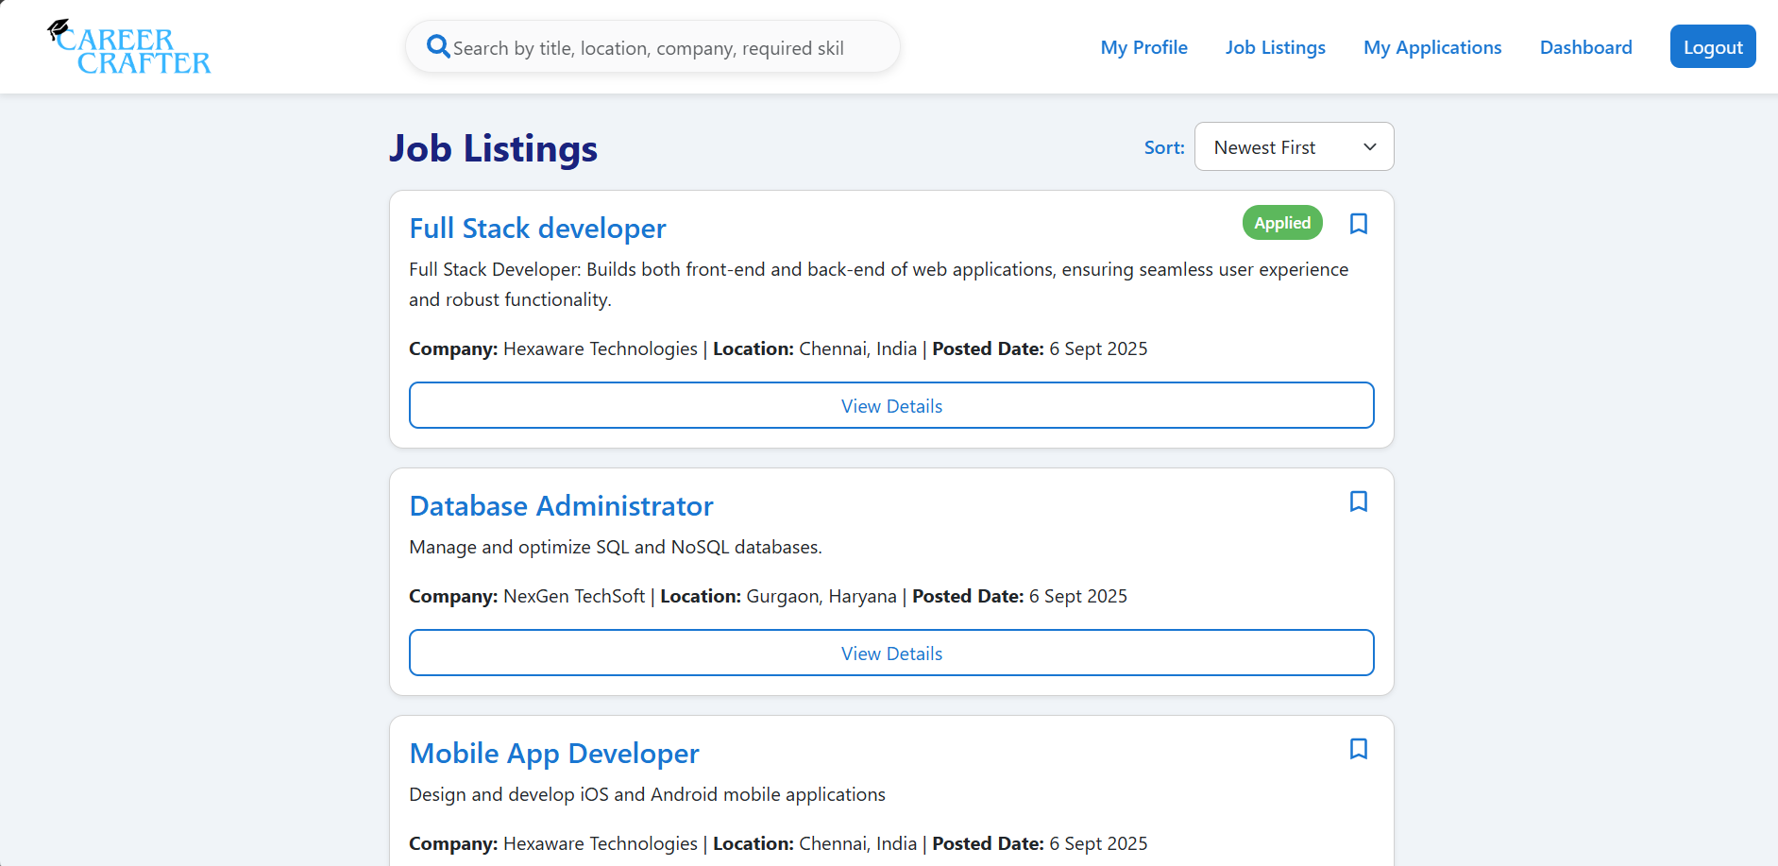
Job Listings:

Slide 12
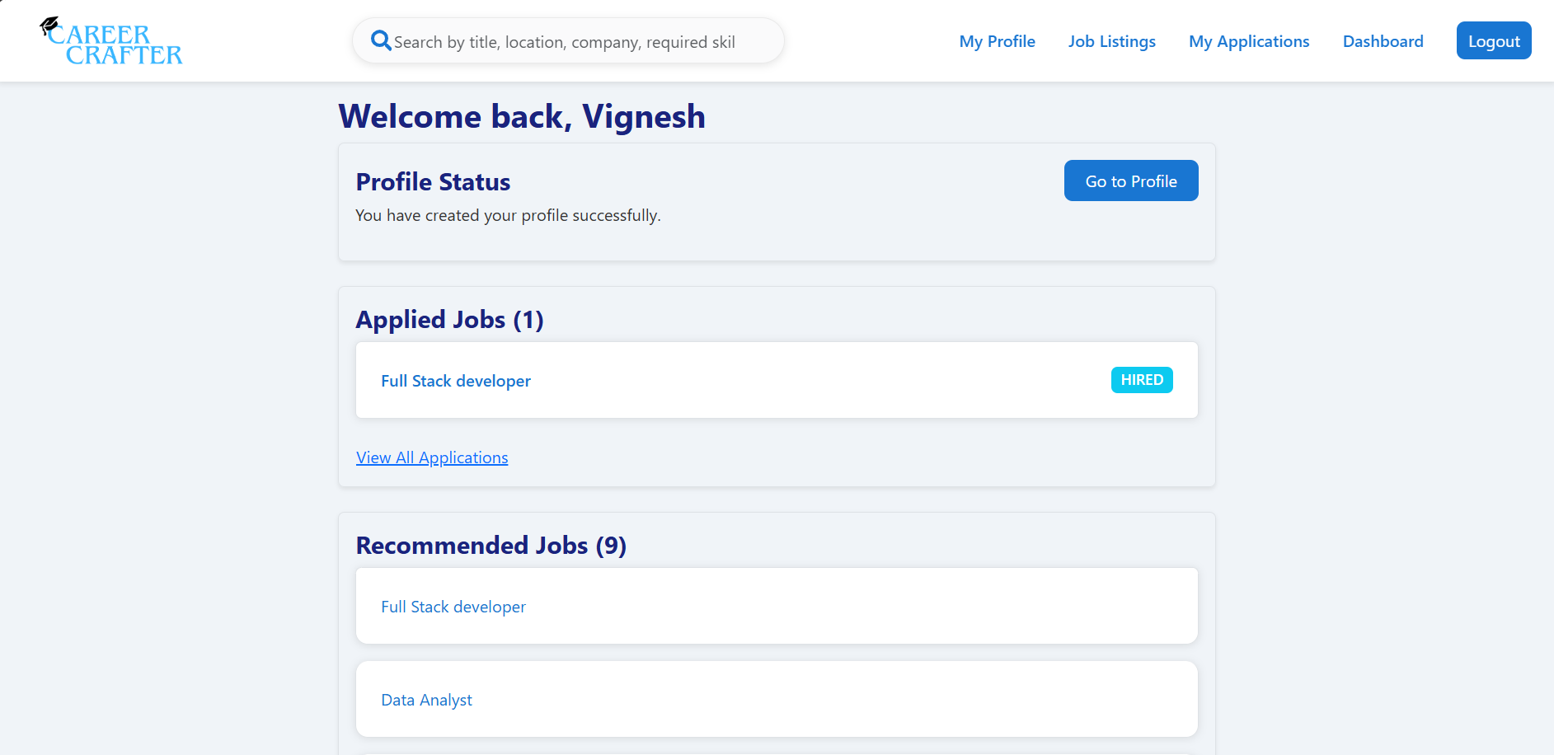
JobSeeker Dashboard:

Slide 13
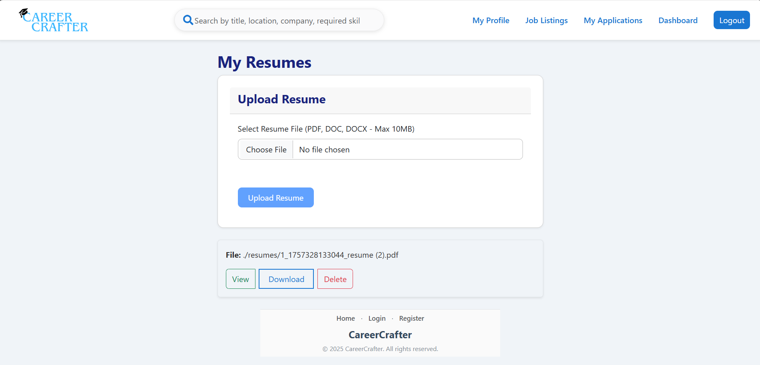
Resume Manager:

Slide 14
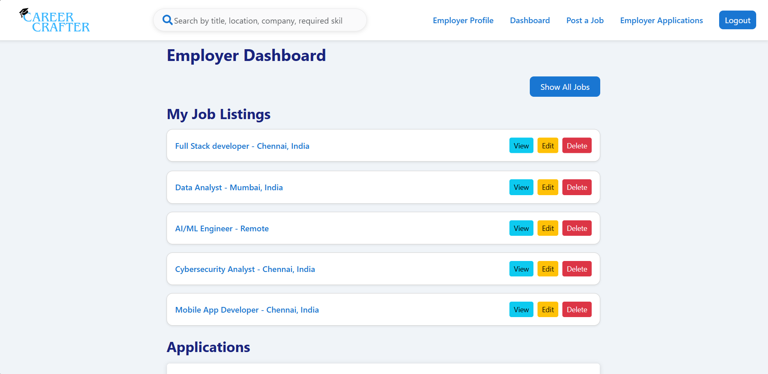
Employer Dashboard:

Slide 15
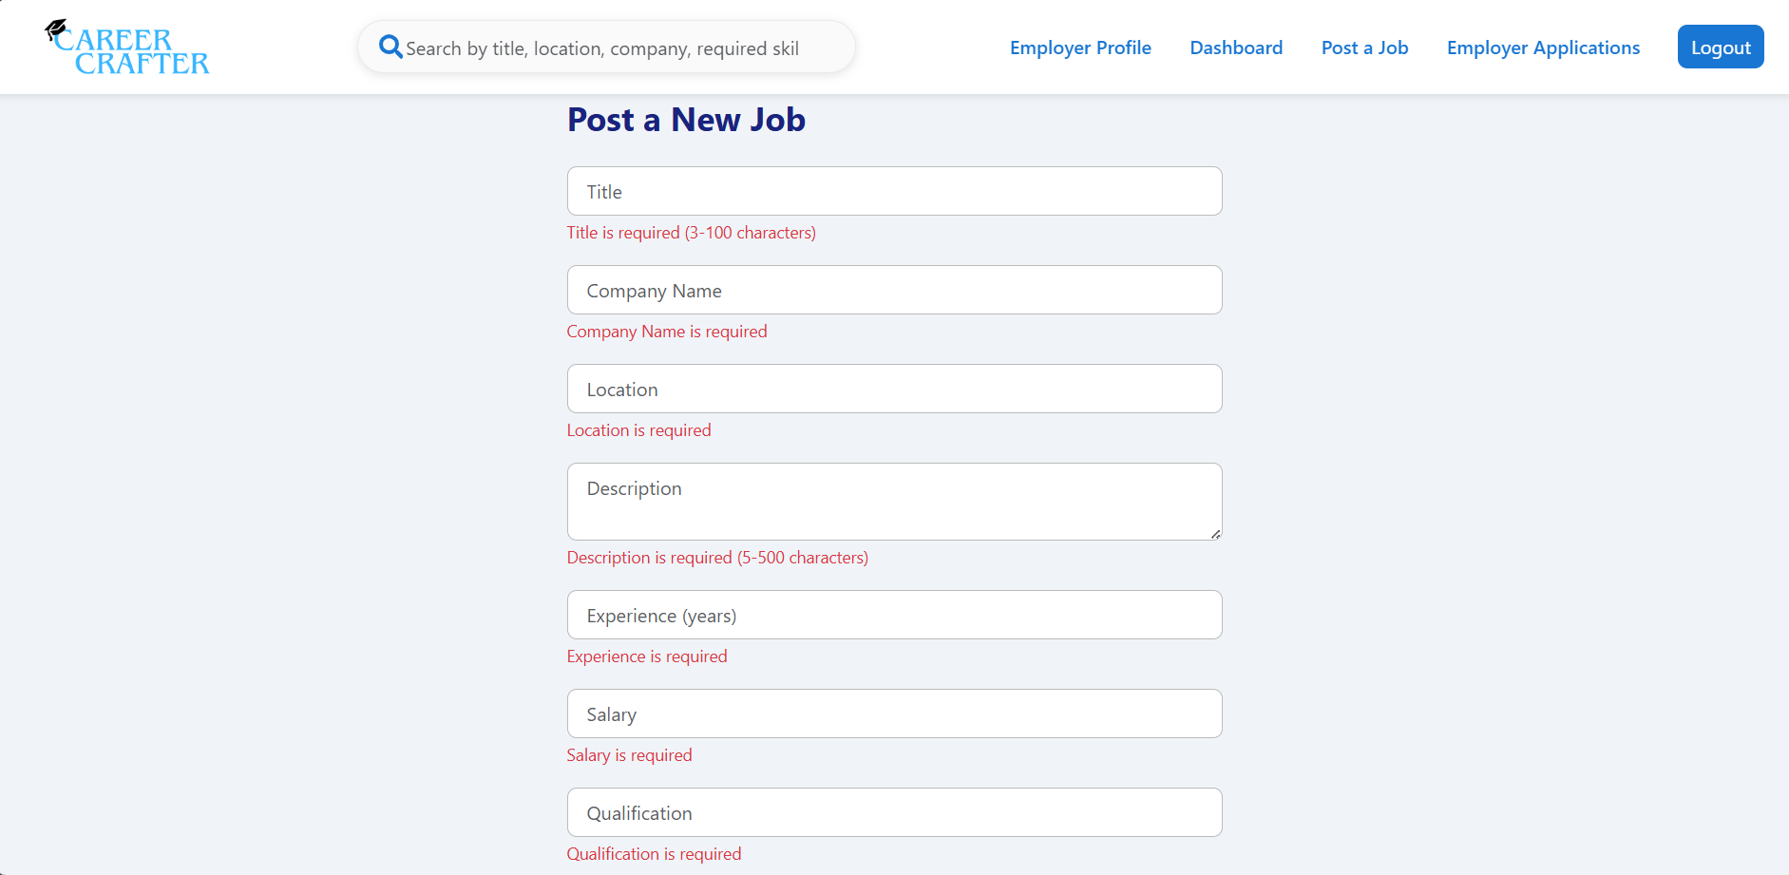
Validations for Posting Job:

Slide 16
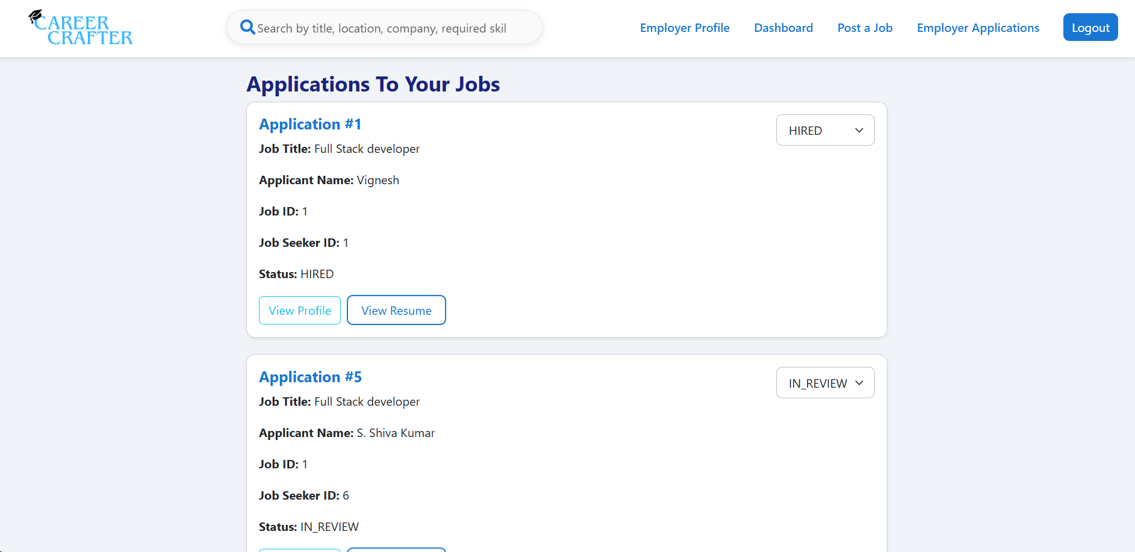
Applications Page:

Slide 17
Thank you

